Slide 1
PoC : Smart Routing
XE + CES Collaboration

Slide 2
Agenda
Context
PoC Use Case
Routing Flow – High Level Technical Design
Agent Skill ML Model
Demo
Summary & Next Steps

Slide 3
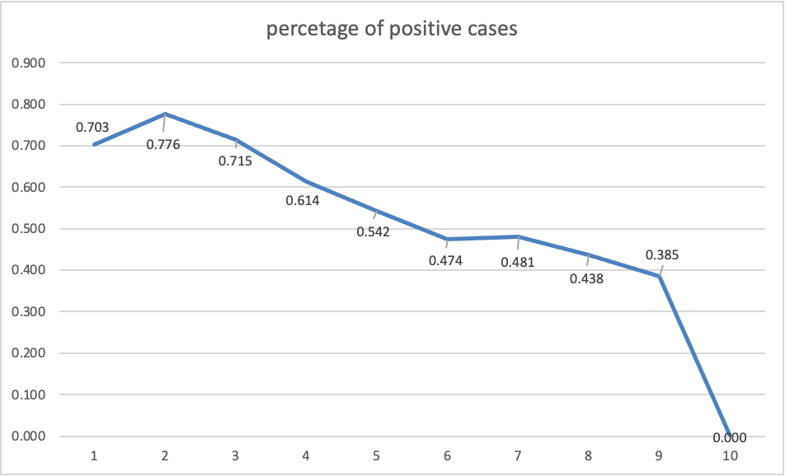
Context
Customer don’t like to be bounced around
Over a period, Agent tends to pick up a niche
Emp Name | Activation | Billing | End User Account Management | Team Account Management | Troubleshooting
Genki Ito | 77.97% | 88.58% | 85.93% | 89.62% | 82.22%
Rovin Yeshashwik |  | 93.36% | 88.67% | 0.00%
Daisuke Itou | 87.63% | 90.18% | 82.73% | 33.33% | 82.93%
Kayo Tada | 85.59% | 91.74% | 86.84% | 87.00% | 89.66%
Shuuhei Kaneko | 89.76% | 89.97% | 89.19% |  | 100.00%
Keiko Yoshijima | 88.74% | 89.34% | 82.78% |  | 80.00%
Ikumi Ohkawa | 80.85% |  | 73.02% | 100.00% | 75.09%
Himanshu Sharma | 90.96% | 84.38% | 70.42% |  | 82.42%
Nikhath Fathima N | 75.00% | 86.21% | 97.70% |  | 100.00%
Erika Watanabe | 82.02% |  | 58.33% | 100.00% | 84.75%
Yuuya Sasaki | 88.43% | 89.13% | 88.49% |  | 100.00%
Hiromi Sato | 93.59% | 90.31% | 87.68% | 90.77% | 89.02%
Yuka Uesugi | 82.41% | 87.03% | 83.85% | 85.76% | 86.79%
Koutarou Hashino | 92.86% | 88.19% | 86.65% | 100.00% | 81.48%
Sumit Sharma | 50.27% | 83.94% | 86.00% |  | 86.51%
Dereck Thomas | 100.00% | 92.28% | 84.21% |  | 100.00%
Abba Diana Princy Samuel | 94.70% |  |  |  | 91.14%
Takaaki Inokuchi | 89.33% | 85.17% | 82.01% | 85.81% | 75.86%
Sonali Sharma | 75.00% | 95.82% | 96.61% | 97.00% | 66.67%
Momoko Takahashi | 77.89% |  | 73.81% | 71.43% | 81.88%
Kanako Hujiwara | 86.54% | 88.56% | 81.48% | 100.00% | 0.00%
Nitiysh Kalra | 92.59% | 88.33% | 90.29% |  | 0.00%
Yukina Yano | 93.02% | 94.18% | 87.13% | 100.00% | 96.55%
Hitomi Nakamura | 78.13% |  | 100.00% |  | 83.80%
Aman Jain | 95.10% |  | 66.67% |  | 87.45%
Harshal Sahu | 93.35% | 83.33% | 78.43% |  | 90.00%
Mayuko Izumi | 91.91% | 91.77% | 85.09% | 86.00% | 75.00%
Hypothesis: For the customer to have the most valuable & satisfying experience with Adobe they need to interact with the agent who is best suited to solve their issue

Slide 4
PoC Use Case
Ability to introduce any foreign element into the contact routing flow and use it to influence the outcome
Steps taken to functionally prove out smart routing end to end
Built ML model to map agent best in solving L2 issues
Integrate ML model with AWS connect platform*
Built "Smart Routing Handler" to get ranked list of agents based on conversation context
Check for Availability and Capacity of Agents in AWS Contact Flow
Route to highest ranked agent who is available
* used AWS Hackathon environment for the PoC

Slide 5
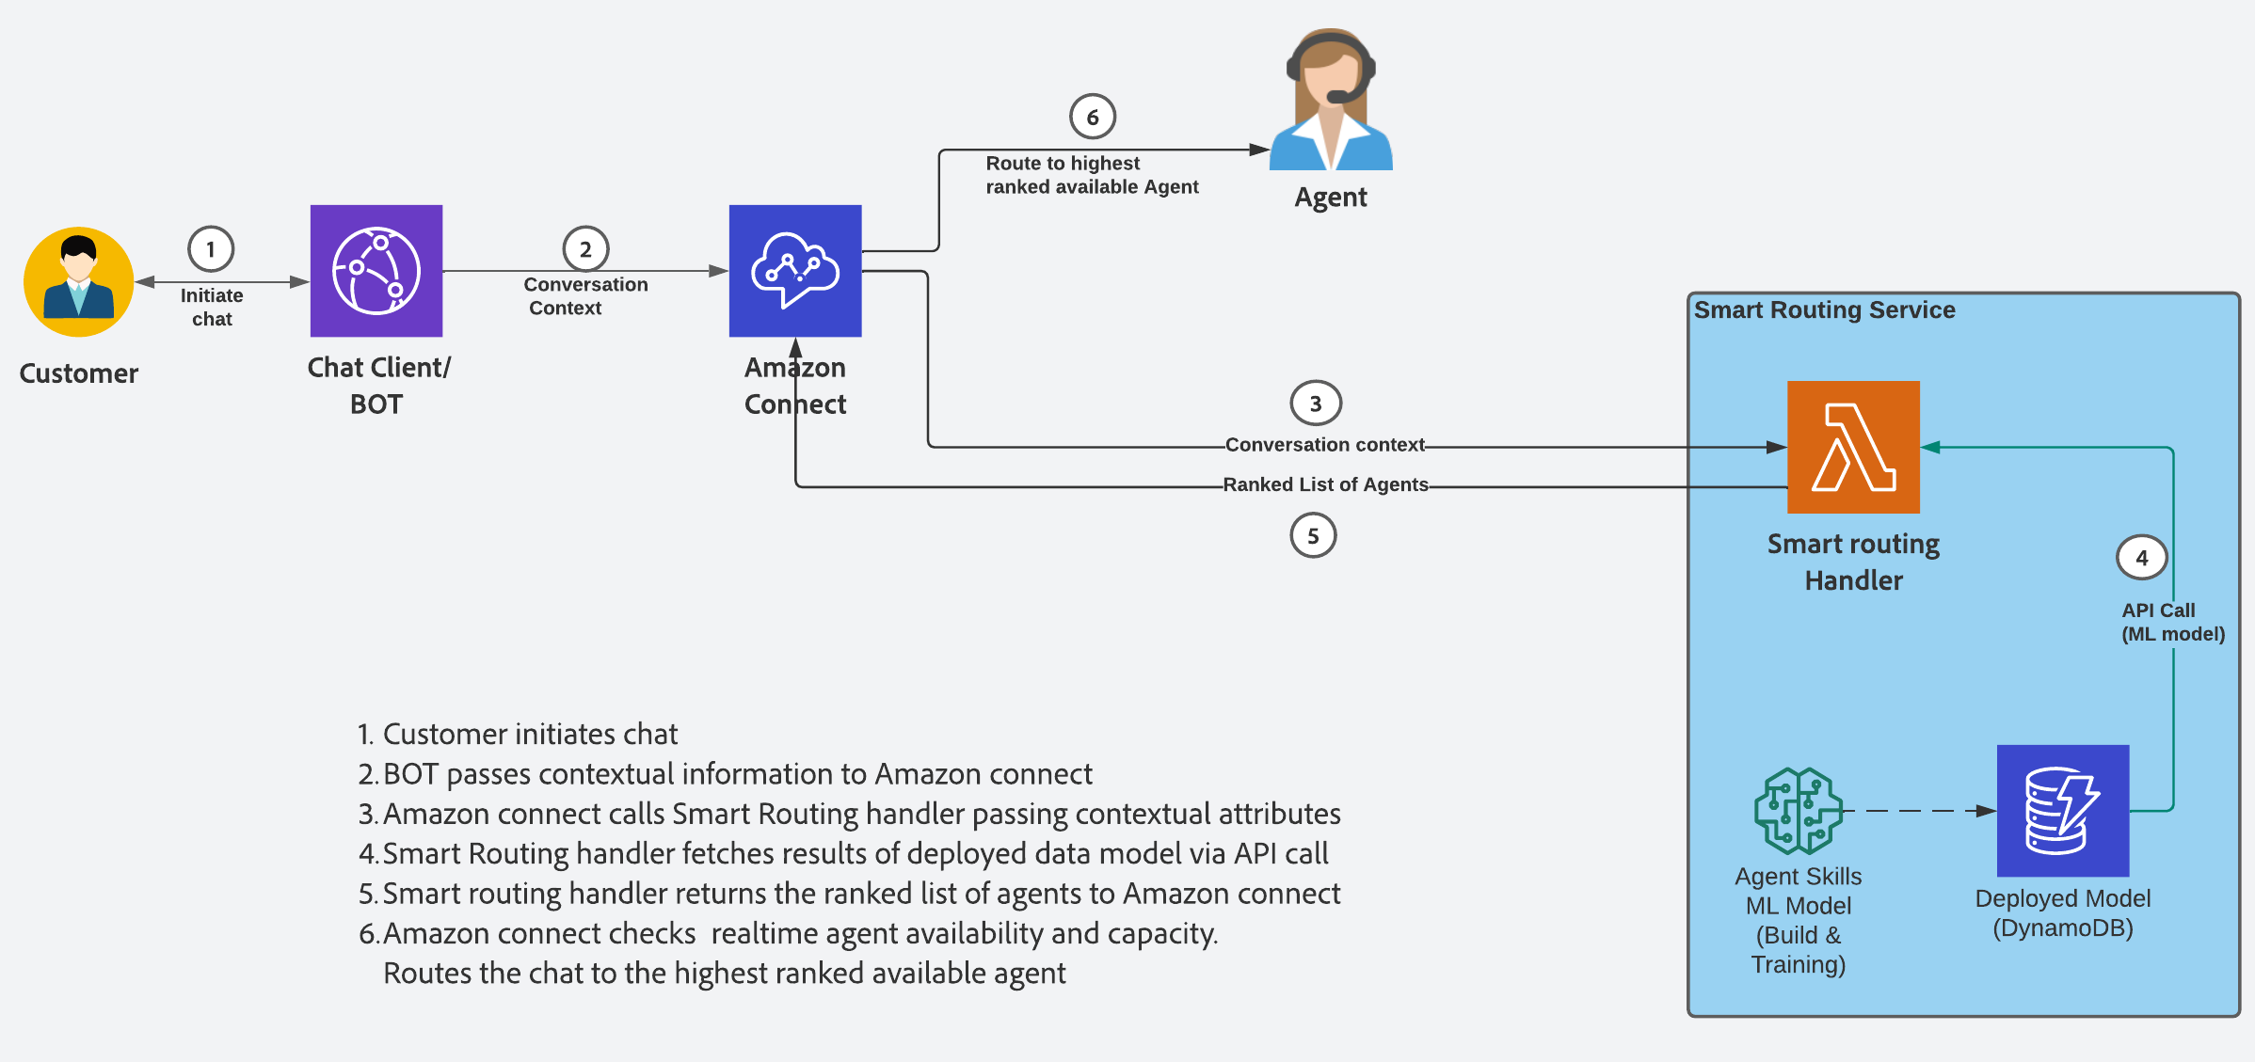
Technical Design – Smart Routing

Slide 6
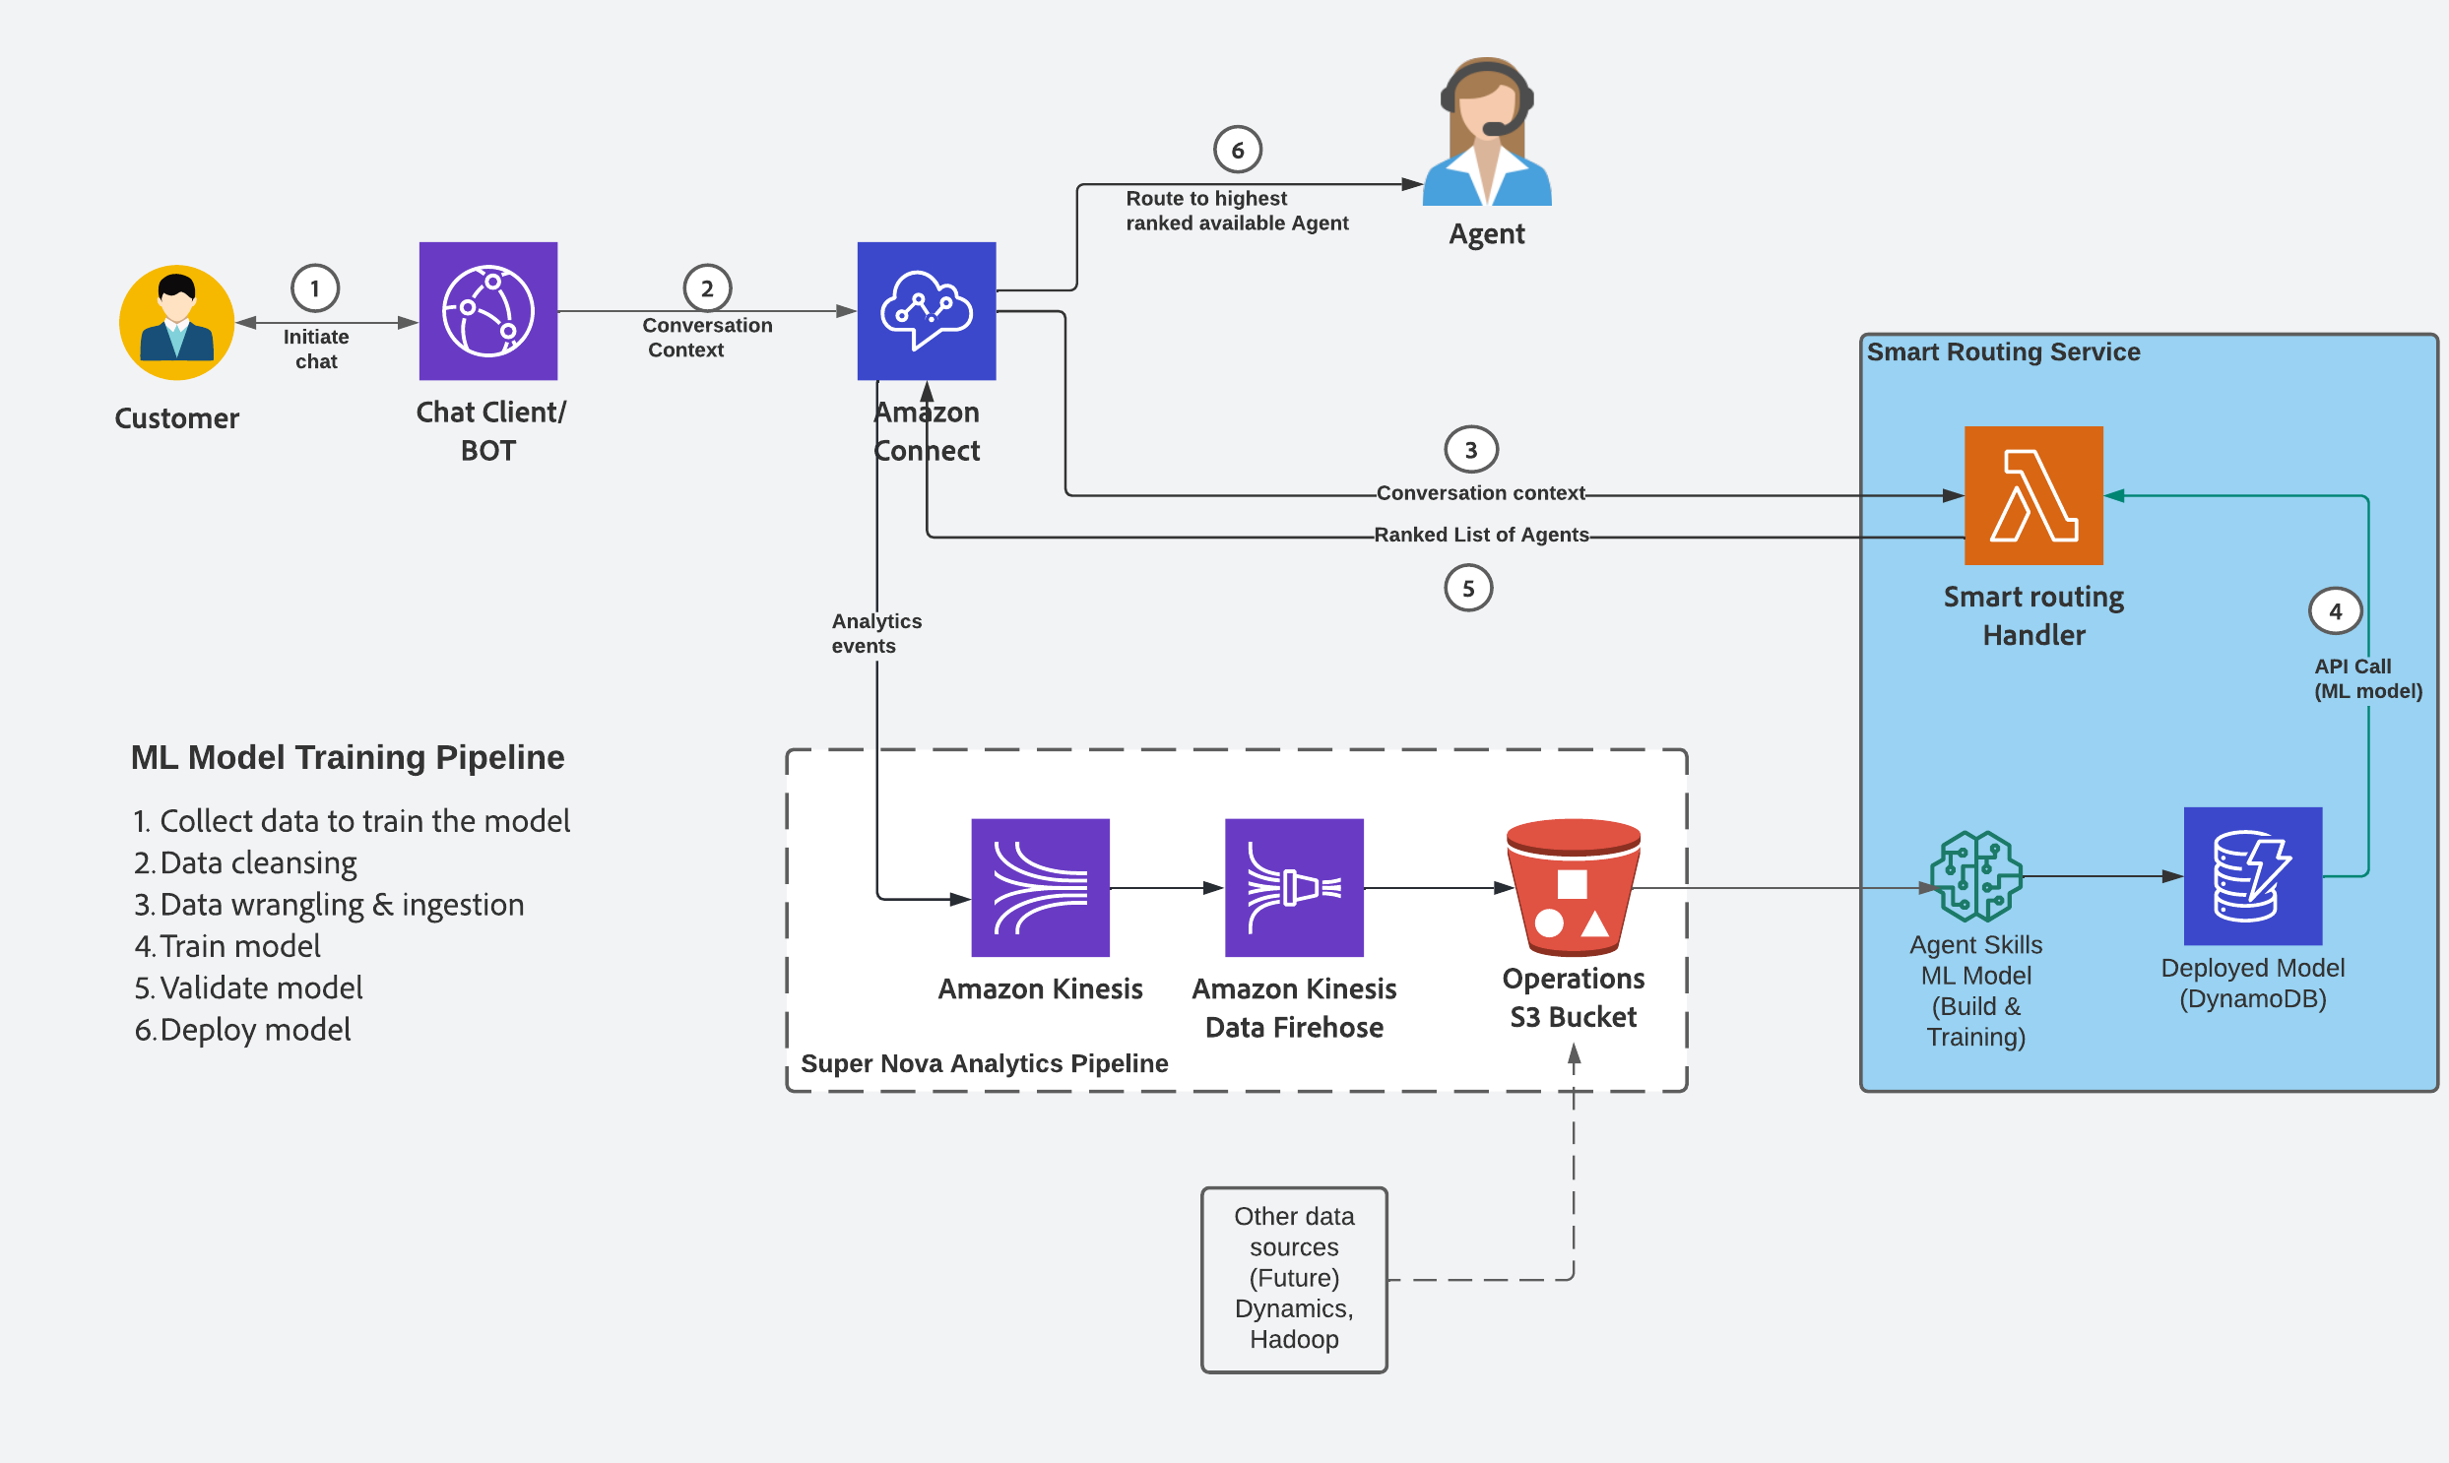
Technical Design – ML Training Pipeline

Slide 7

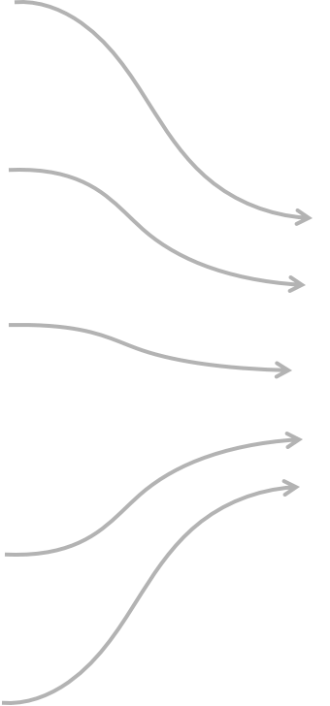

Agent Skill – ML Model
Conversation Health Score (CHS)
Score: 70.0
Handle Time
CPH
ARD
Score: 69.5
Customer Tenure
Agent Tenure
# of agents
Wait Time
Score: 68.5
Agent Response Time
# of turns
Data wrangling
Logistic Regression ML Model
Customer Issue
Score: 67.5
Agent Scorecard
Input parameters
Identifier
Notes:
Identifiers: CHS – Debajit will speak on why CHS over other identifiers
Input variables: Avg Handling time, No of agents serving the case, CPH(Contact Per hour), Agent Tenure, Waiting Time, Resolution days
Output target variables: Agent Score for L2 issue type

Slide 8
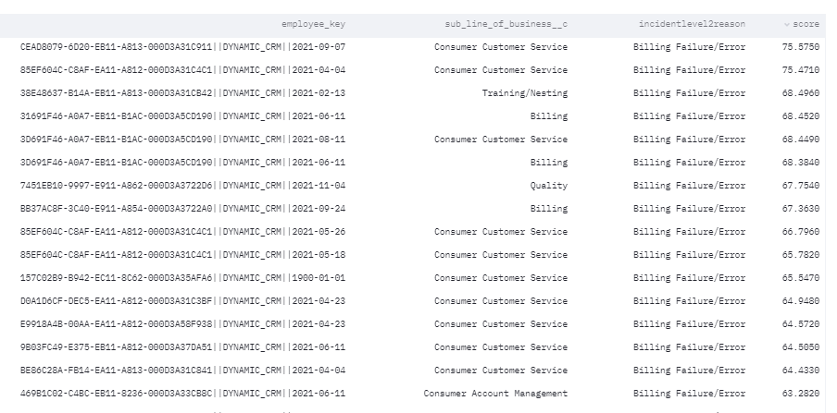
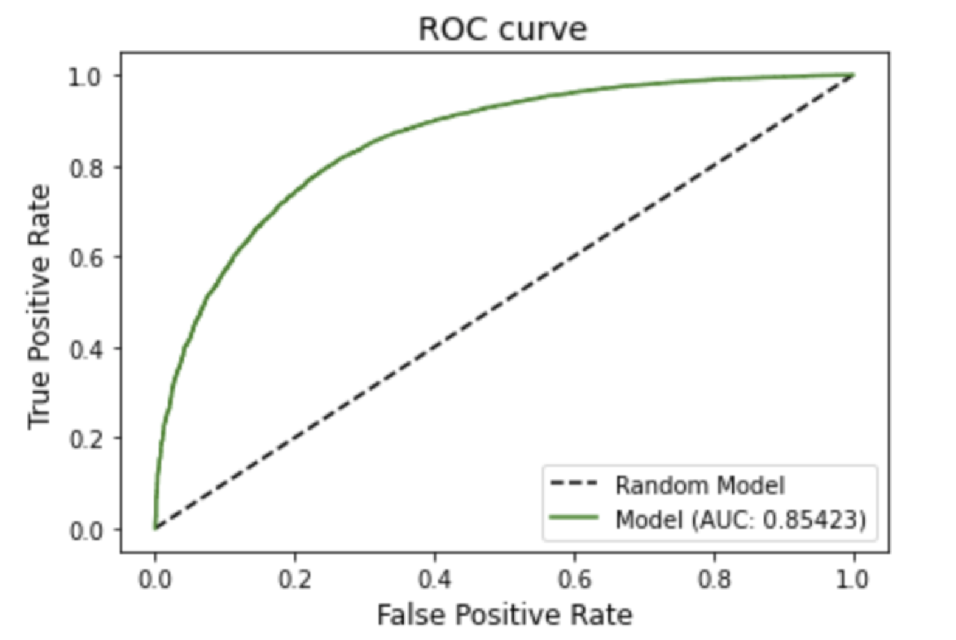
Model Output
L2 Issue: Billing Failure/ Error
Model accuracy ~85%
Refer this dashboard to see model in working
Refer this wiki to learn more about this model

Slide 9
Demo

Slide 10
Intent – Activation Issues
Intent – Billing Failure
Utterance(s) - Activation error
Utterance(s) - I have a billing question
Agent | Model Score | Status
Debajit | 65.1815 | Offline
Narayan | 61.0404 | Online
Akshay | 57.6942 | Online
Katie | 56.7429 | Offline
Vikas | 56.6881 | Offline
Prasanna | 56.6811 | Offline
Agent | Model Score | Status
Akshay | 75.5750 | Online
Santosh | 75.4710 | Offline
Vikas | 68.4960 | Offline
Prasanna | 68.4520 | Offline
Katie | 68.4490 | Offline
Narayan | 68.3840 | Online

Slide 11
Summary & Next Steps
We believe this functionality will enable us to create bespoke & fulfilling experience for our customer agnostic of their channel preference.
The business KPI’s it will positively impact
Higher CSAT% & Customer Effort Score
Higher RFT
Lower Transfer Rate
Reduction in Repeat
Faster Resolution Time
We have also done the preliminary technical design review with AWS team, and they are onboard.
We have kept the Agent Load as a factor to watch out for. In the current scope of PoC we have kept it ASIS
Future work –
A/B testing in Production
Feedback loop to continuously improve ML model
Align with AWS on their roadmap
Next Steps:
PoC Feedback from the attendee
Approval to add this to SuperNova’s backlog?

Slide 12
Thank You

Slide 13

Agent Skill – ML Model
Conversation Health Score
Logistic regression Model
Score: 70.0
Avg. Handling Time
Score: 69.5
# agents serving the case
CPH (Contact Per Hour)
Score: 68.5
Agent Tenure
Score: 67.5
Wait Time
Input parameters
Data wrangling
ML Model
Output Scorecard
Notes:
Model Type: logistic Regression
Gives out an output I.e. a probability function between 0 and 1, which is the score of the agent.

Slide 14
Context & potential impact (Hypothesis) - Debajit
What is the ASIS (include the MVP for SuperNova) routing flow - Narayan
What is the new proposed flow that we are recommending - Debajit
Demo
High level architecture of the data flow and continuous learning - Narayan
The data model (how it is working) – Katie & Prasanna
What is the RTP plan – Narayan & Vikas

Slide 15
POC Use case
Functionally prove out smart routing end to end
ML model creation
Integrate ML model with AWS connect platform
Get Ranked list of Agents
Check for Availability and Capacity of Agents
Route to highest ranked agent who is available

Slide 16
DEMO TIME

Slide 17
Model Explanation
What are the attributes?
-- We have a correlation view to show columns i.e. attributes – wiki attach. Slide 5
What is the target variable?
-- Conversation health score (positive or negative - -1 or 1)
What is the type of model?
-- Data Engineering (WOE)/ Logistic Regression Model
How are we measuring model accuracy/ performance?
-- AUC – Area Under Curve – Wiki attach
Pre-Post testing.
1. hypothesis : average number of agents serving per case will go down.
2. hypothesis: probability of having better experience goes up as experts begin to handle different user interactions
3. hypothesis: CPH – Contact per hour will go up, hence experience will be happier, better NPS.
Insights
1. easy to solve issue type and hard to solve issue type clustering - https://wiki.corp.adobe.com/display/DIA/Agent+Performance

Slide 18
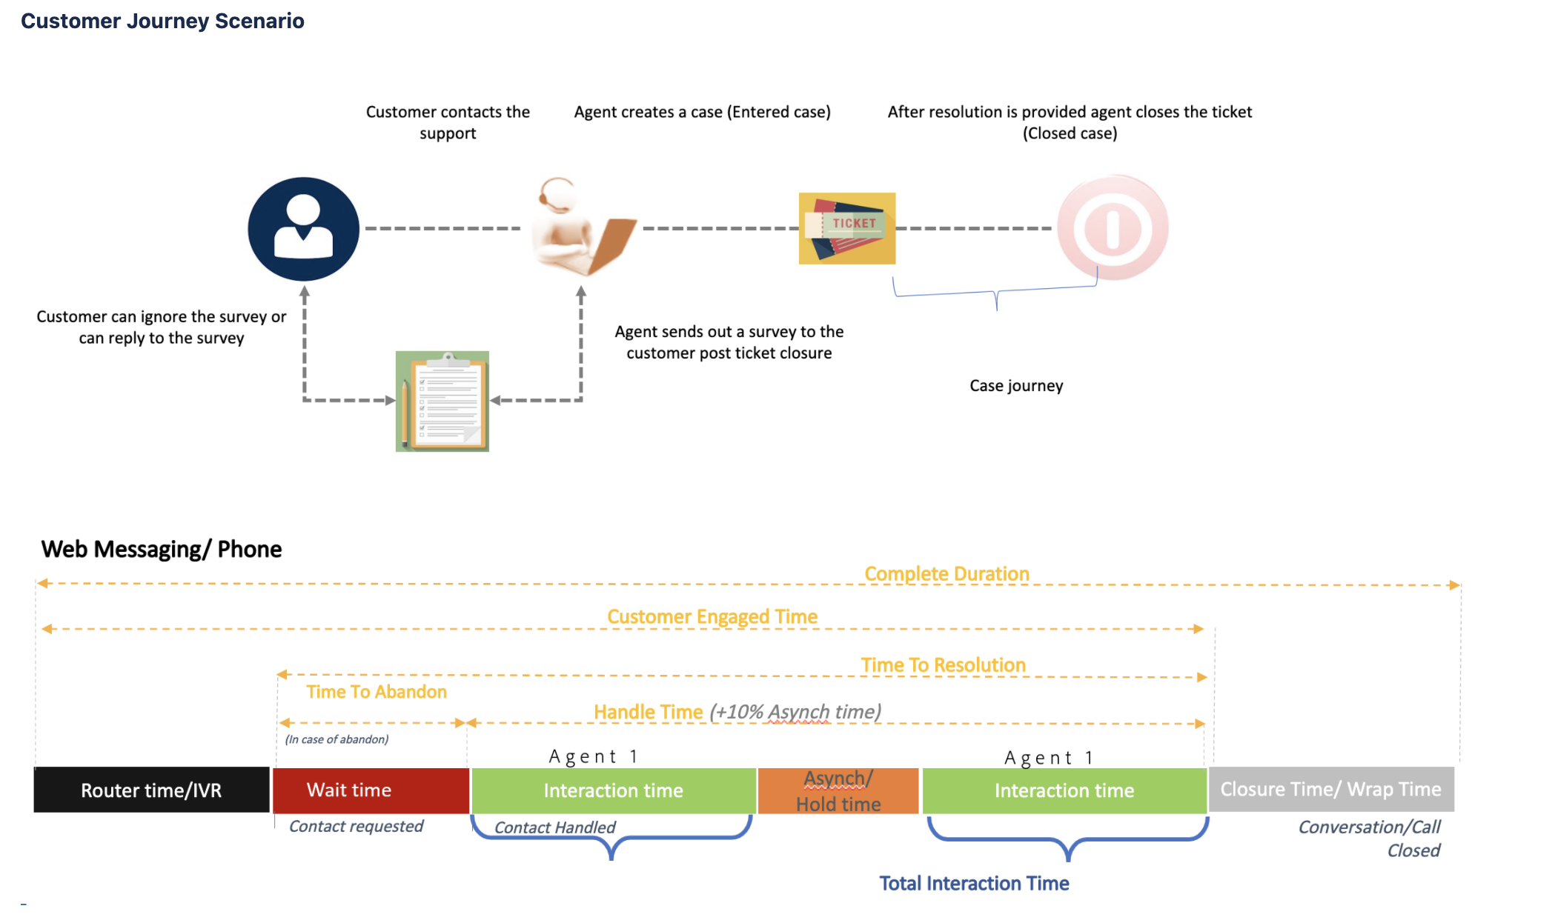
What are the attributes?
case | agent | issue type | wait time | avg response time | agent handling time | number of turns per conversation | number of agents handling | agent tenure | resolution days | billable days | working hours | CPH | CHS
1 | A | download | 100 | 20 | 40 | 28 | 2 | 600 | 0 | 6 | 7 | 2.3 | 1
2 | B | payment | 300 | 30 | 30 | 29 | 2 | 500 | 0 | 7 | 7 | 2.5 | 1
3 | C | download | 200 | 100 | 60 | 20 | 4 | 400 | 0 | 8 | 7 | 1 | -1
4 | D | account | 700 | 400 | 70 | 10 | 1 | 200 | 1 | 3 | 7 | 0.8 | -1

Slide 19
model efficiency

Slide 20
Next steps
Post MVP - Integrate in SuperNova project
A/B Test (floodgate integration)

